Slide 1
Keras Layers
Assignment 1
Sneha Ravikumar

Slide 2
Contents
Core Layers: Dense, Activation, Dropout, Flatten, Reshape, Permute, Merge, Activity Regularization, Masking, Highway, MaxoutDense
Convolutional Layers: Convolutional1D/2D/3D, Atrous Convolution1D/2D, Separable Convolution2D, Deconvolution2D, Cropping 1D/2D/3D, UpSampling 1D/2D/3D, ZeroPadding1D/2D/3D
Pooling Layers: MaxPooling1D/2D/3D, AveragePooling1D/2D/3D, GlobalMaxPooling1D/2D, GlobalAveragePooling1D/2D
Locally Connected Layers: LocallyConnected1D/2D
Recurrent Layers: Recurrent, SimpleRNN, GRU, LSTM
Embedding Layers
Advanced Activation Layers: LeakyReLU, PRelu, ELU, ParametricSoftplus, ThresholdReLU
Normalization Layers: Batch Normalization
Noise Layers: Gaussian Layers, GuassianDropout
Wrapper Layers

Slide 3
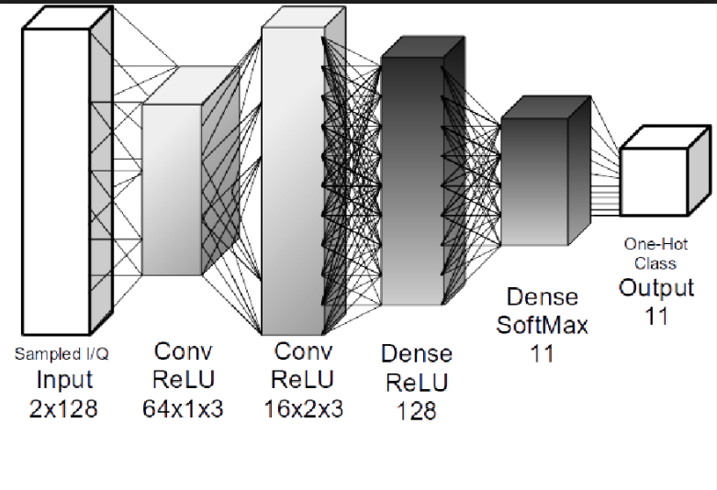
What are layers?
Models in Keras are defined as a sequence of layers
We create a Sequential model and add
layers one at a time until we are happy
with our network topology
Defining the number of layers
and their types are heuristics that
we can use and often the best network
structure is found through a process
of trial and error experimentation

Slide 4
Keras Layers – Methods
layer.get_weights() : Returns the weights of the layer as a numpy array
layer.set_weights(weights) : sets the weight of layer with an input array
If a layer has a single node (i.e. if it isn't a shared layer), you can get its input tensor, output tensor, input shap and output shape via:
layer.input, layer.output, layer.input_shape, layer.output_shape

Slide 5
Core Layers
Dense Layer - Just your regular fully connected NN layer.
keras.layers.core.Dense(output_dim, init='glorot_uniform', activation=None, weights=None, W_regularizer=None, b_regularizer=None, activity_regularizer=None, W_constraint=None, b_constraint=None, bias=True, input_dim=None)
Arguments:
output_dim: int > 0
init: name of initialization function
activation: name of activation function to use . Default: Linear Activation(ie. "linear" activation: a(x) = x)
weights: list of Numpy arrays to set as initial weights
W_regularizer: instance of WeightRegularizer (eg. L1 or L2 regularization), applied to the main weights matrix
b_regularizer: instance of WeightRegularizer, applied to the bias
activity_regularizer: instance of ActivityRegularizer, applied to the network output
W_constraint: instance of the constraints module (eg. maxnorm, nonneg), applied to the main weights matrix
b_constraint: instance of the constraints module, applied to the bias
bias: whether to include a bias (i.e. make the layer affine rather than linear)
input_dim: dimensionality of the input (integer).

Slide 6
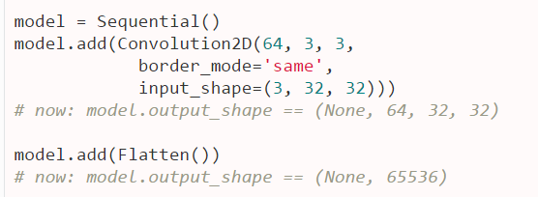
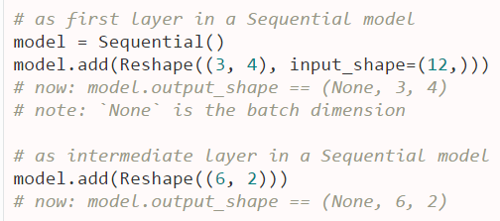
Activation:
keras.layers.core.Activation(name of activation function to use) - Applies an activation function to an output
(Softplus,softsign,relu,tanh,sigmoid,hard_sigmoid,linear)
Droput: keras.layers.core.Dropout(p) float between 0 and 1. Fraction of the input units to drop.
Dropout consists in randomly setting a fraction p of input units to 0 . i.e, deactivate certain units (neurons) in a layer
Flatten : keras.layers.core.Flatten() - Flattens the input. Does not affect the batch size.
Reshape: keras.layers.core.Reshape(target_shape)
Reshapes an output to a certain shape.

Slide 7
RepeatVector - keras.layers.core.RepeatVector(n) – Number of times to repeat
Merge : A Merge layer can be used to merge a list of tensors into a single tensor, following some merge mode.
model1 = Sequential() model1.add(Dense(32, input_dim=32))
model2 = Sequential() model2.add(Dense(32, input_dim=32))
merged_model = Sequential()
merged_model.add(Merge([model1, model2], mode='concat', concat_axis=1))
Mode: 'sum', 'mul', 'concat', 'ave', 'cos', 'dot', 'max'.
ActivityRegularization :
keras.layers.core.ActivityRegularization(l1=0.0, l2=0.0)
Layer that returns its input unchanged, but applies an update to the cost function based on the activity of the input
Masking
keras.layers.core.Masking(mask_value=0.0)
Masks an input sequence by using a mask value to identify timesteps to be skipped
For each timestep in the input tensor (dimension #1 in the tensor), if all values in the input tensor at that timestep are equal to mask_value, then the timestep will masked (skipped) in all downstream layers (as long as they support masking)
If any downstream layer does not support masking yet receives such an input mask, an exception will be raised.

Slide 8
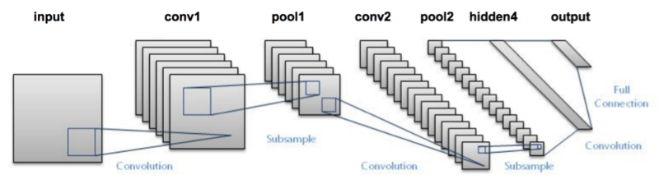
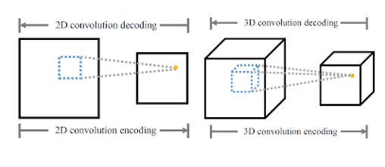
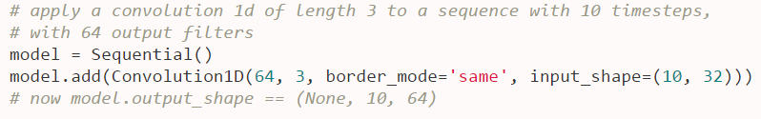
Convolutional Layers
Dimensionality as the number of dimensions the filter is repeated along.
A typical 2D convolution applied to an RGB image would have a filter shape of (3, filter_height, filter_width), so it combines information from all channels into a 2D output.
If you wanted to process each color separately (and equally), you would use a 3D convolution with filter shape (1, filter_height, filter_width)
1D convolution is useful for data with local structure in one dimension, like audio or time series
Convolution1D/2D/3D:
Output
Dimension
Filter
Length
valid -no padding around input or feature map,
same-some padding around input or feature map, making the output feature map's size same as the input.
https://ujjwalkarn.me/2016/08/11/intuitive-explanation-convnets/

Slide 9
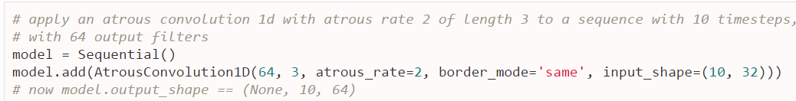
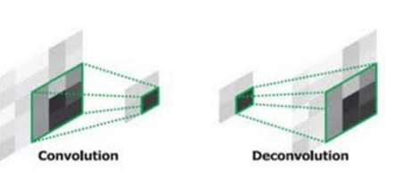
Atrous convolution1D/2D: dilated convolution or convolution with holes. allows us to explicitly control how densely to compute feature responses
Factor for kernel dilation
SeparableConvolution2D
Separable convolutions consist in first performing a depthwise spatial convolution (which acts on each input channel separately) followed by a pointwise convolution which mixes together the resulting output channels.
The depth_multiplier argument controls how many output channels
are generated per input channel in the depthwise.
Deconvolution2D
Transposed convolution operator for filtering windows of two-dimensional inputs

Slide 10
Cropping1D –Cropping layer for 1D input (e.g. temporal sequence). It crops along the time dimension (axis 1).
keras.layers.convolutional.Cropping1D(cropping=(1, 1))
Cropping2D - Cropping layer for 2D input (e.g. picture). It crops along spatial dimensions, i.e. width and height.
keras.layers.convolutional.Cropping2D(cropping=((0, 0), (0, 0)), dim_ordering='default')
UpSampling1D/2D/3D
Repeat each temporal step length times along the time axis
keras.layers.convolutional.UpSampling1D(length=2)
Repeat the rows and columns of the data by size[0] and size[1] respectively.
keras.layers.convolutional.UpSampling2D(size=(2, 2), dim_ordering='default')
Repeat the first, second and third dimension of the data by size[0], size[1] and size[2] respectively.
keras.layers.convolutional.UpSampling3D(size=(2, 2, 2), dim_ordering='default')
tuple of int (length 2) - How many units should be trimmed off at the beginning and end of the cropping dimension (axis 1)
The upsampling factors for rows and columns.
The upsampling factors for dim1, dim2 and dim3

Slide 11
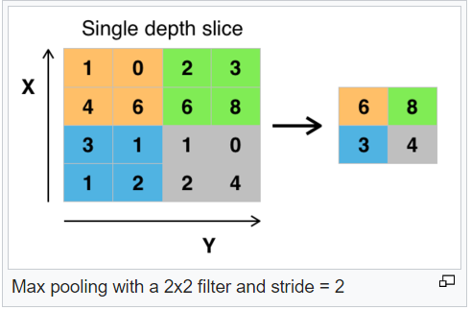
Pooling Layers : Non-linear down-sampling
MaxPooling1D - Max pooling operation for temporal data
keras.layers.pooling.MaxPooling1D(pool_length=2, stride=2, border_mode='valid')
It partitions the input image into a set of non-overlapping rectangles and,
for each such sub-region, outputs the maximum
Reduce the spatial size of the representation - control overfitting
Arguments:
pool_length: size of the region to which max pooling is applied
stride: integer, or None. factor by which to downscale. 2 will halve the input. If None, it will default to pool_length.
border_mode: 'valid' or 'same‘
MaxPooling2D - Max pooling operation for spatial data
pool_size: tuple of 2 integers, factors by which to downscale (vertical, horizontal). (2, 2) will halve the image in each dimension.
MaxPooling3D - Max pooling operation for 3D data (spatial or spatio-temporal).
pool_size: tuple of 3 integers, factors by which to downscale (dim1, dim2, dim3). (2, 2, 2) will halve the size of the 3D input in each dimension.
Similar: AveragePooling1D/2D/3D
GlobalMaxPooling1D
GlobalAveragePooling2D

Slide 12
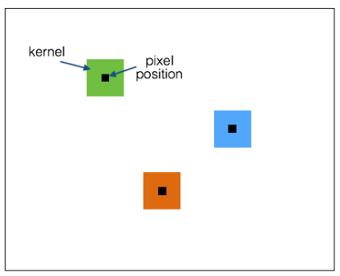
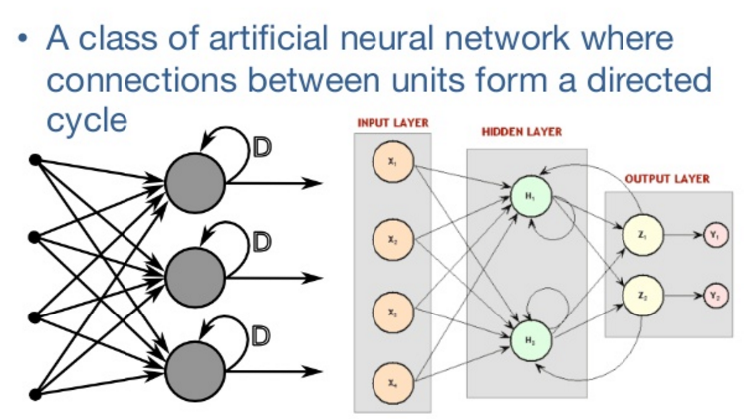
Locally Connected Layer
LocallyConnected1D/2D:
The LocallyConnected 1D/2D layers work similar to the Convolution1D/2D layers
Weights are unshared - a different set of filters is applied at each different patch of the input.
Recurrent - Abstract base class for recurrent layers
Fully-connected RNN where the output is to be fed back to input.
keras.layers.recurrent.LSTM(arguments)
keras.layers.recurrent.GRU(arguments)
keras.layers.recurrent.SimpleRNN(arguments)
output_dim: dimension of the internal projections and the final output.
init: weight initialization function. Can be the name of an existing function (str), or a Theano function inner_init: initialization function of the inner cells.
activation: activation function. Can be the name of an existing function (str), or a Theano function inner_activation: activation function for the inner cells.
W_regularizer: instance of WeightRegularizer (eg. L1 or L2 regularization), applied to the input weights matrices.
U_regularizer: instance of WeightRegularizer (eg. L1 or L2 regularization), applied to the recurrent weights matrices.
b_regularizer: instance of WeightRegularizer, applied to the bias.
dropout_W: float between 0 and 1. Fraction of the input units to drop for input gates.
dropout_U: float between 0 & 1. Fraction of the input units to drop for recurrent connections.

Slide 13
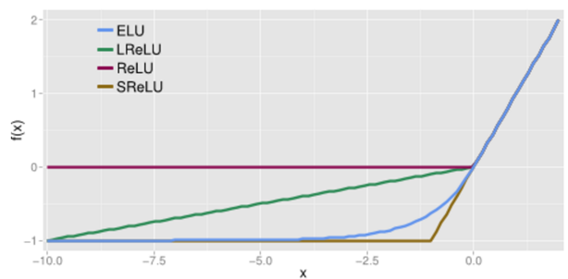
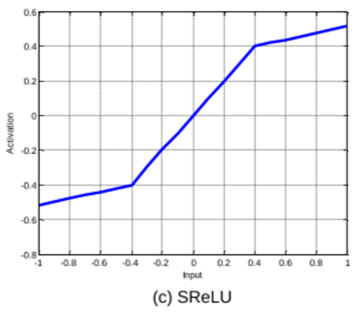
Advanced Activation Layers
LeakyReLU
keras.layers.advanced_activations.LeakyReLU(alpha=0.3)
f(x)=alpha * x for x < 0, f(x) = x for x >= 0
Special version of a RLU that allows a small gradient
Prelu: Parametric Rectified Linear Unit
f(x)=alphas * x for x < 0, f(x) = x for x >= 0
Alphas is a learned array with the same shape as x
ELU: Exponential Linear Unit
f(x) = alpha * (exp(x) - 1.) for x < 0
f(x) = x for x >= 0
Tries to make the mean activation close to zero and as it is an exponential function it does not saturate
SReLU: S-shaped Rectified Linear Unit.
SReLU consists of three piecewise linear functions, which are formulated by four learnable parameters
It takes in five parameters: The activation functions for the left and right of the Slope and the intercept and a shared_axes

Slide 14
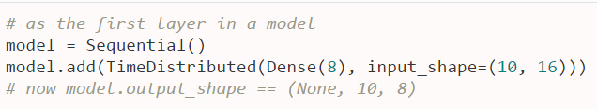
Normalization Layers: Normalize the activations of the previous layer at each batch, i.e. Applies a transformation that maintains the mean activation close to 0 and the activation standard deviation close to 1.
Noise Layers:
GaussianNoise
Apply to the input an additive zero-centered Gaussian noise with standard deviation sigma. This is useful to mitigate overfitting (you could see it as a kind of random data augmentation)
As it is a regularization layer, it is only active at training time
keras.layers.noise.GaussianNoise(sigma)
GaussianDropout:
Apply to the input an multiplicative one-centered Gaussian noise with standard deviation sqrt(p/(1-p))
keras.layers.noise.GaussianDropout(p) --→ p: float, drop probability
Wrapper Layers:
Time Distributed Layer: This wrapper allows to apply a layer to every temporal slice of an input.
he input should be at least 3D (Temporal – Time related aspect)
The inner operation is the same y=f(Wx+b),
where f(x) is activation function,W and b are weight and bias.
Bidirectional Wrappers
Bidirectional wrapper for RNNs.
keras.layers.wrappers.Bidirectional(layer, merge_mode='concat', weights=None)

